Slide 1
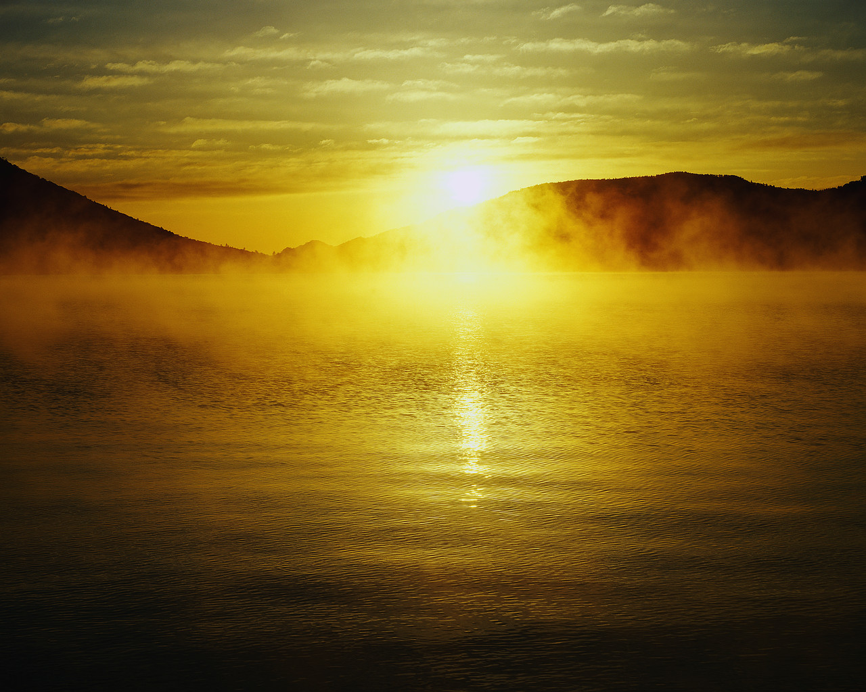
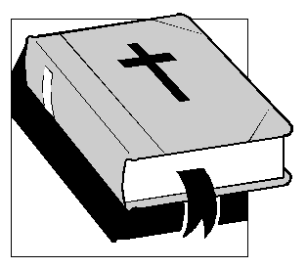
Why You May Know The Bible
Reasons
is the WORD of GOD
(part 3b)
2 Peter 1:19-21

Slide 2
Previously:
Historical Accuracy of The Bible
  Global Flood
    Bible teaches a global flood
    Evidence of the flood is everywhere
    Unbelievers admit a flood on Mars but not on earth…why the difference?
    Prophecy of “WHAT” unbelievers would assert (2 Peter 3:1-4)

Slide 3
A Prophecy of WHY
Unbelievers Would Affirm Such

Slide 4
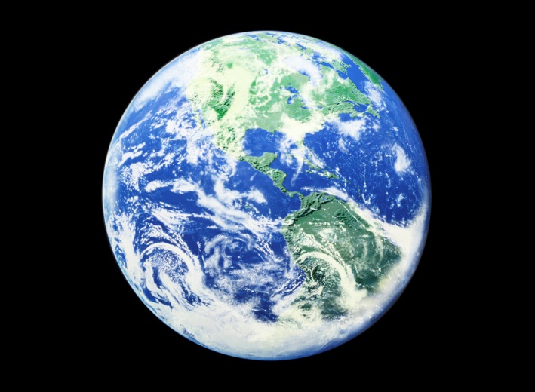
Man’s Contradictions
Why The Difference?
No Liquid Water, But
Evidence For Flood!
Lots Of Liquid water, But
No Evidence For Flood!
EARTH
⁵ For this they willfully forget: that by the word of God the heavens were of old, and the earth standing out of water and in the water,
⁶ by which the world that then existed perished, being flooded with water.
2 Peter 3 (NKJV)

Slide 5
Rejection Of Truth: From
WILL or UNDERSTANDING?
Examples:
  Luke 16:27-31
  John 12:9-11
  Matthew 28:11-15
  Acts 4:16-20
WHY!
⁵ For this they willfully forget: that by the word of God the heavens were of old, and the earth standing out of water and in the water,
⁶ by which the world that then existed perished, being flooded with water.
2 Peter 3 (NKJV)

Slide 6
Man’s Contradictions
Why The Difference?
No Liquid Water, But
Evidence For Flood!
Lots Of Liquid water, But
No Evidence For Flood!
EARTH
⁷ But the heavens and the earth which are now preserved by the same word, are reserved for fire until the day of judgment and perdition of ungodly men.
2 Peter 3 (NKJV)

Slide 7
Final Warning
⁸ But, beloved, do not forget this one thing, that with the Lord one day is as a thousand years, and a thousand years as one day.
⁹ The Lord is not slack concerning His promise, as some count slackness, but is longsuffering toward us, not willing that any should perish but that all should come to repentance.
¹⁰ But the day of the Lord will come as a thief in the night, in which the heavens will pass away with a great noise, and the elements will melt with fervent heat; both the earth and the works that are in it will be burned up.
2 Peter 3 (NKJV)

Slide 8
Final Warning
¹¹ Therefore, since all these things will be dissolved, what manner of persons ought you to be in holy conduct and godliness,
¹² looking for and hastening the coming of the day of God, because of which the heavens will be dissolved, being on fire, and the elements will melt with fervent heat?
¹³ Nevertheless we, according to His promise, look for new heavens and a new earth in which righteousness dwells.
¹⁴ Therefore, beloved, looking forward to these things, be diligent to be found by Him in peace, without spot and blameless;
2 Peter 3 (NKJV)

Slide 9
Final Warning
¹⁵ and consider that the longsuffering of our Lord is salvation—as also our beloved brother Paul, according to the wisdom given to him, has written to you,
¹⁶…which untaught and unstable people twist to their own destruction, as they do also the rest of the Scriptures.
¹⁷ You therefore, beloved, since you know this beforehand, beware lest you also fall from your own steadfastness, being led away with the error of the wicked;
¹⁸ but grow in the grace and knowledge of our Lord and Savior Jesus Christ. To Him be the glory both now and forever. Amen.
2 Peter 3 (NKJV)

Slide 10
1 Peter 3:20-22
20 who formerly were disobedient, when once the Divine longsuffering waited in the days of Noah, while the ark was being prepared, in which a few, that is, eight souls, were saved through water.
21 There is also an antitype which now saves us—baptism (not the removal of the filth of the flesh, but the answer of a good conscience toward God), through the resurrection of Jesus Christ,
22 who has gone into heaven and is at the right hand of God, angels and authorities and powers having been made subject to Him.

